Slide 1
RFM Dashboard
File created on: 03/10/2024 7:51:22 pm GMT-4

Slide 2
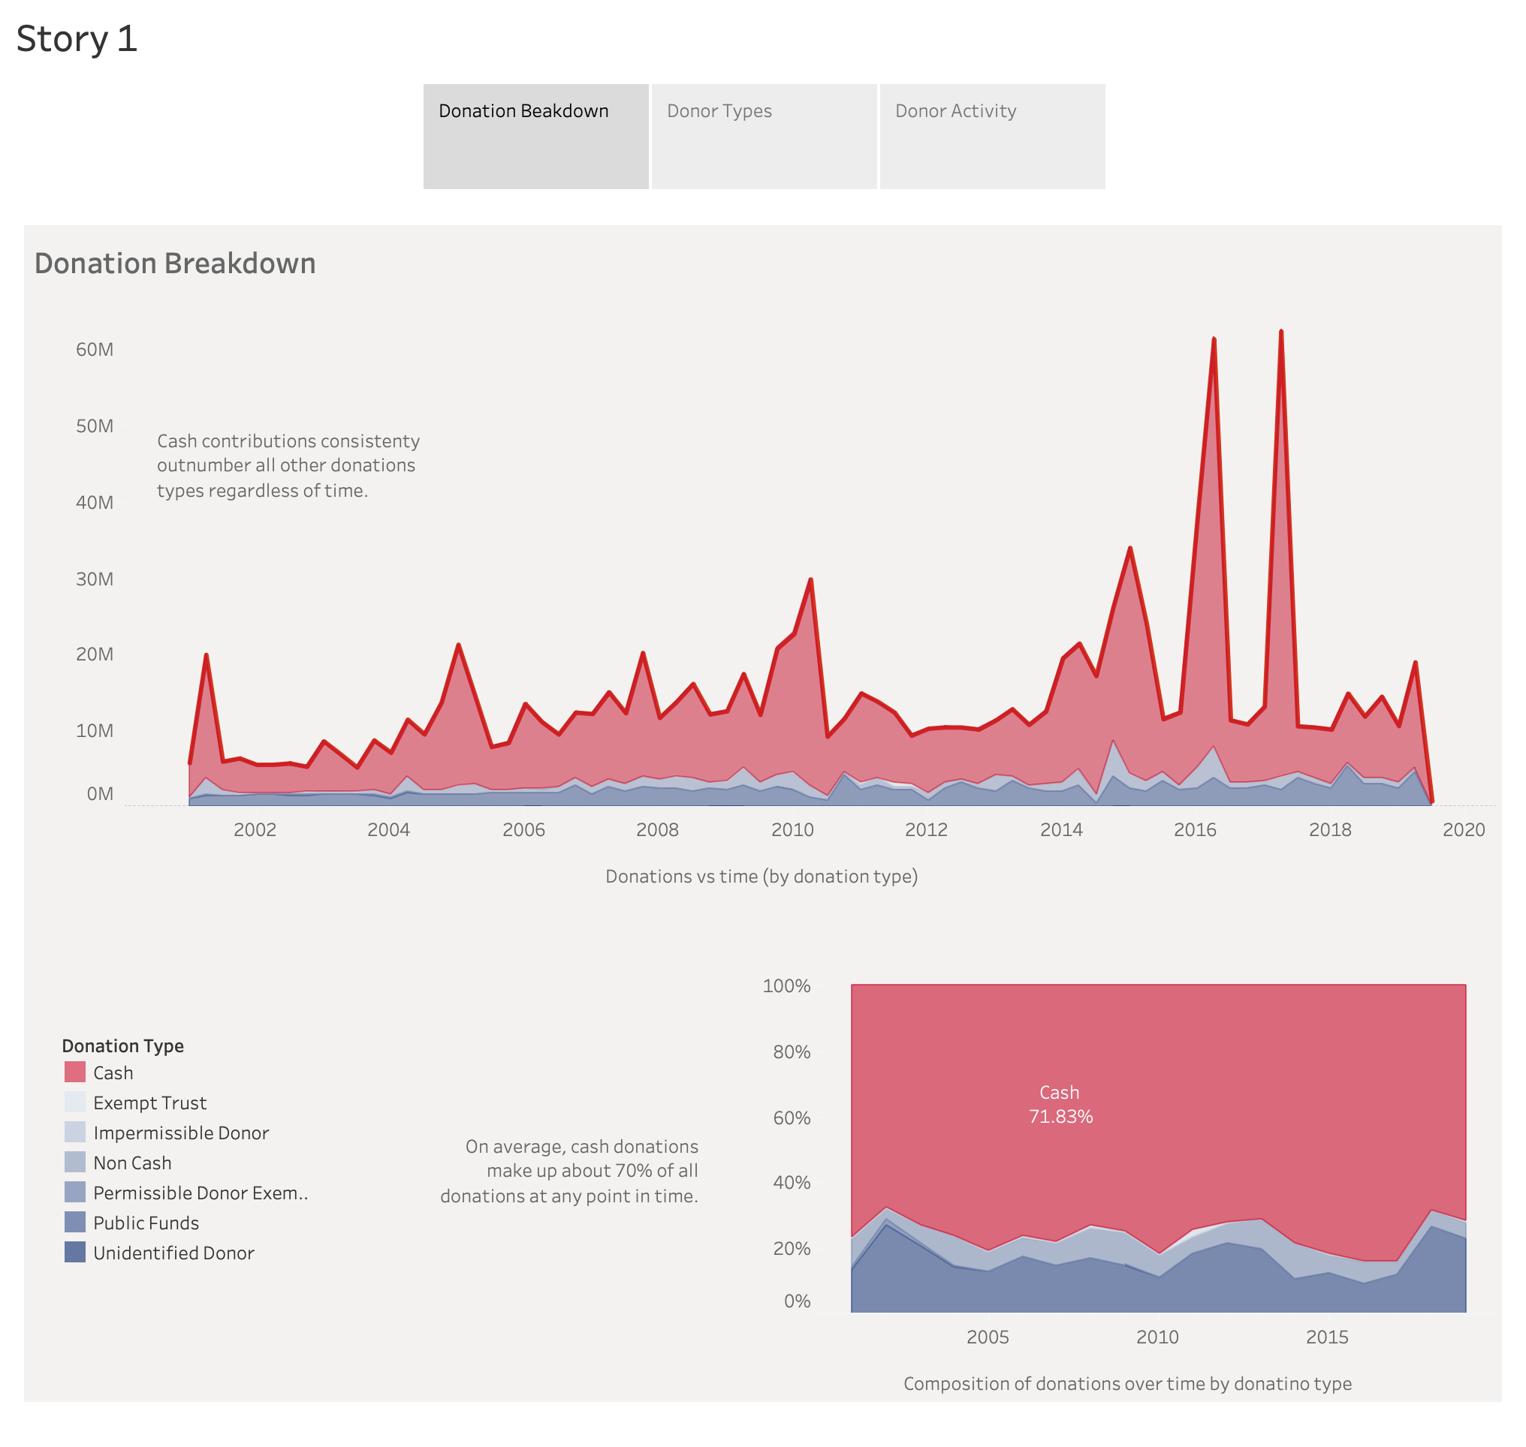

Slide 3
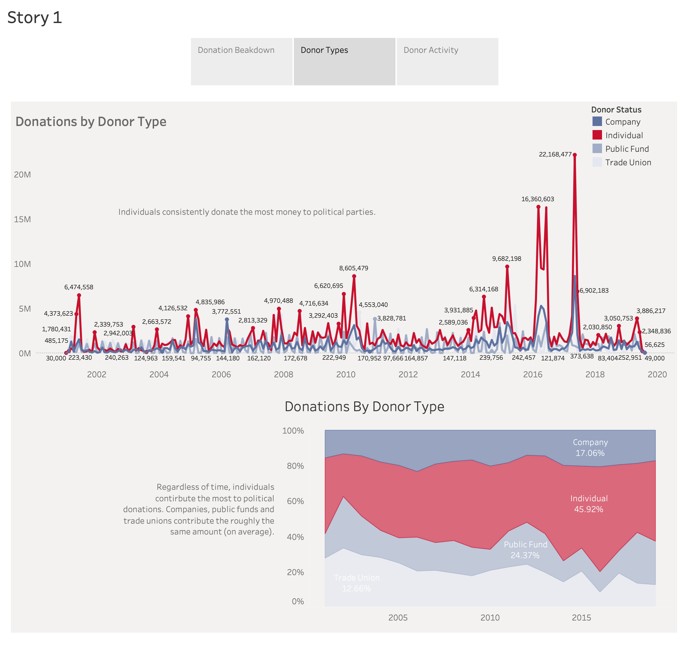

Slide 4
